Slide 1
Chapter 3
Information Systems Development

Slide 2
Capability Maturity Model
Level 1 - Initial
  no methodology therefore unrepeatable process
Level 2 - Repeatable
  project management but no process methodology
Level 3 - Defined
  standard methodology creates a predictable process
Level 4 - Managed
  measurable quality & productivity of process
Level 5 - Optimized
  continual monitoring & improvement of process

Slide 3
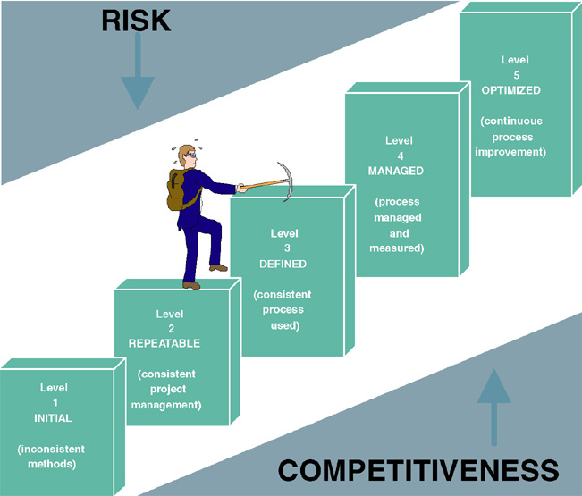
Capability Maturity Model

Slide 4
System Life Cycle
System Development Stage
  use System Development Methodology to build it
System Operation & Maintenance Stage
  use Information Technology
    to use it, keep it running, & support it

Slide 5
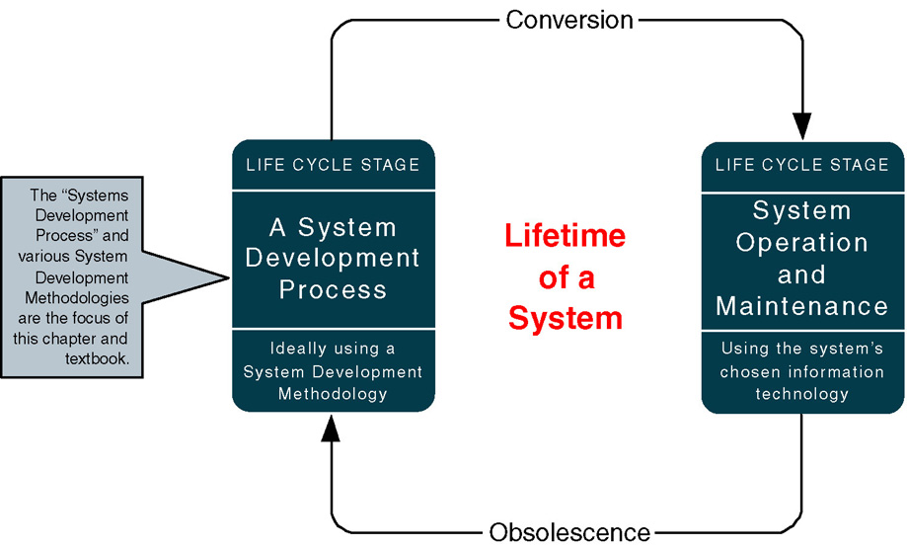
System Life Cycle

Slide 6
Systems Development Principles
Get system users involved
Use problem-solving approach
Establish phases and activities
Document throughout development
Establish standards
Manage the process & projects
Justify systems as capital investments
Don’t be afraid to cancel or revise scope
Divide and conquer
Design systems for growth & change

Slide 7
System Development Phases
Phase 1 Scope Definition
Phase 2 Problem Analysis
Phase 3 Requirements Analysis
Phase 4 Logical Design
Phase 5 Decision Analysis
Phase 6 Physical Design
Phase 7 Construction
Phase 8 Installation

Slide 8
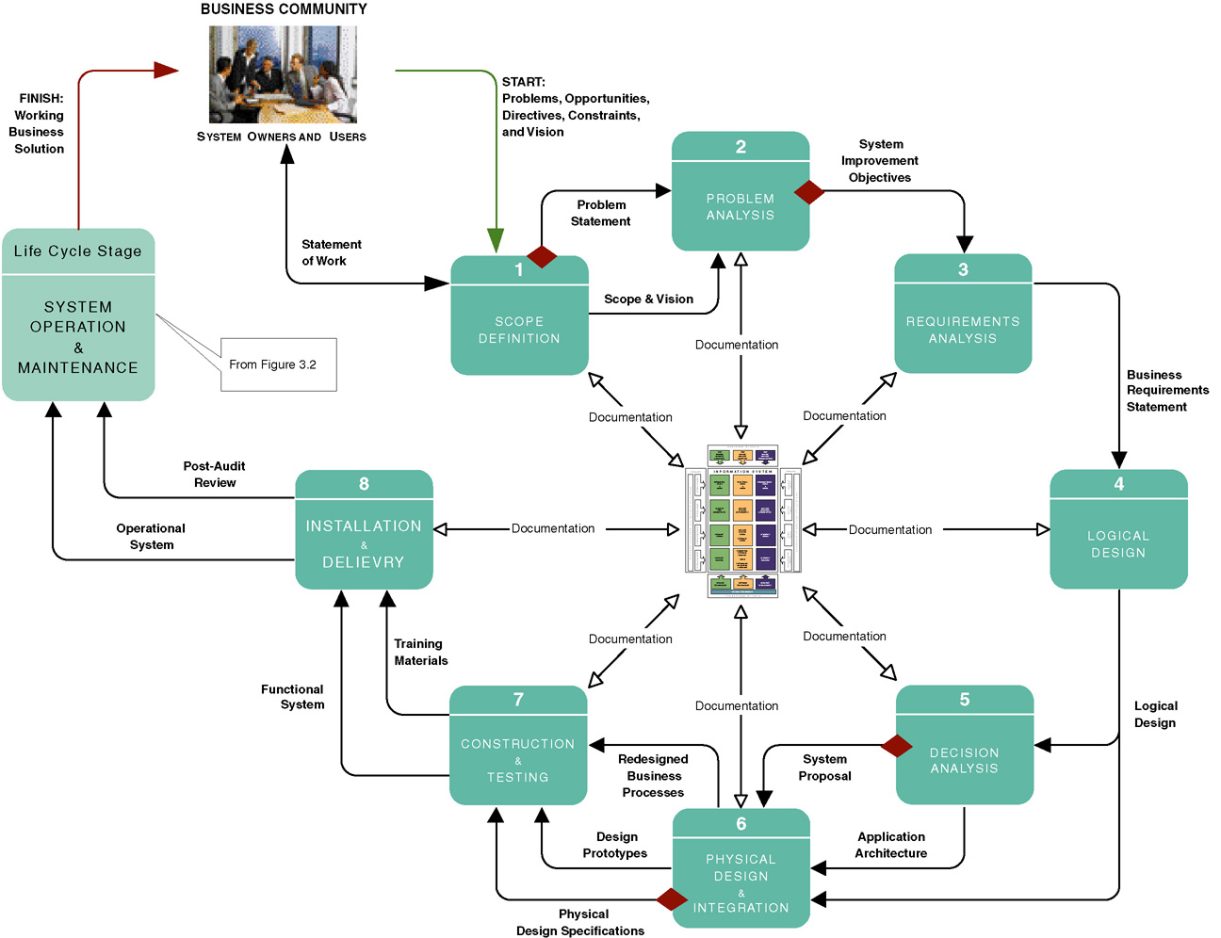
System Development Phases

Slide 9
1. Scope Definition
Define problem, opportunity, or directive
Determine project worthiness
Establish project
  charter
  scope
  preliminary requirements and constraints
  participants
  budget
  schedule

Slide 10
2. Problem Analysis
Analyze existing system
Cancel if problem is not worth solving
If approved continue to next phase, or
Reduce or expand scope, then continue to next phase

Slide 11
3. Requirements Analysis
Collect information from users through interviews, questionnaires, and meetings
Identify the Data, Process, and Interface requirements
Determine what are the requirements are, NOT how they will be accomplished

Slide 12
4. Logical Design
Translate requirements into a technology independent system model
Validate the requirements for completeness and consistency

Slide 13
5. Decision Analysis
Identify candidate solutions
Evaluate candidate solutions for :
  technical feasibility
  operational feasibility
  economic feasibility
  schedule feasibility
  risk feasibility
Recommend a candidate solution

Slide 14
6. Physical Design
addresses how technology will be used in the new system
must adhere to technical design standards to ensure:
  completeness
  usability
  reliability
  performance
  quality

Slide 15
7. Construction
Build and test a system that fulfills business requirements and design specifications
Implement the interfaces between the new system and existing system
Develop final documentation

Slide 16
8. Installation
Load databases
Final testing
Conversion
  terminate old system and replace with new system on a specific date
  run both systems in parallel until new system has been deemed acceptable to replace old system
Train users

Slide 17
Operation & Maintenance Stage
System Support
  assisting users
  fixing software defects
  recovering the system
  adapting the system to new requirements

Slide 18
Logical vs. Physical Models
Logical model
a pictorial representation that depicts what a system is or does.
Physical model
a technical pictorial representation that depicts what a system is or does and how the system is implemented.
Notes:
Conversion Notes
This slide is new to the seventh edition.
Teaching Notes
We always emphasize to students that logical models are built in the analysis phases while physical models are built in the design phases after the implementation architecture is selected.

Slide 19
System Development Strategies
Model-Driven Development (MDD)
  Process Modeling
  Data Modeling
  Object Modeling
Rapid Application Development (RAD)
  Prototypes
Commercial Application Package
  Enterprise Resource Planning (ERP)

Slide 20
MDD - Process Modeling
Flowcharts
Data Flow Diagrams (DFD)
Structure Charts

Slide 21
MDD - Data Modeling
1st focus is on data requirements using Entity Relationship Diagrams (ERD)
2nd focus is on process requirements using Data Flow Diagrams (DFD)

Slide 22
MDD - Object Modeling
merges the data and process concerns into singular constructs called Objects
uses Object Diagrams to document a system in terms of its objects and their interactions

Slide 23
MDD
Advantages
Disadvantages
Requirements often more thorough
Easier to analyze alternatives
Design specifications often more stable and flexible
Systems can be constructed more correctly the first time
Time consuming
Models only as good as users' understanding of requirements
Reduces users' role because pictures are not software
Can be Inflexible
Notes:
Conversion Notes
This slide is new to the seventh edition.

Slide 24
Rapid Application Development
Involve users in the analysis, design, and construction activities
Involve owners, users, analysts, designers, and builders in focused, intense workshops
Accelerate requirements analysis and design through iterative construction
Reduce time for users to see working system by using prototypes

Slide 25
RAD
Advantages
Disadvantages
User requirements often uncertain or imprecise
Encourages active user and management participation
Projects get higher visibility and support
Stakeholders see working solutions more rapidly
Errors detected earlier
Testing and training are natural by-products
More natural process because change is expected
May encourage "code, implement, repair" mentality
Can solve wrong problem since problem analysis is abbreviated
May discourage analysts from considering alternatives
Stakeholders reluctant to throw away prototype
Emphasis on speed can adversely impact quality
Notes:
Conversion Notes
This slide is new to the seventh edition.

Slide 26
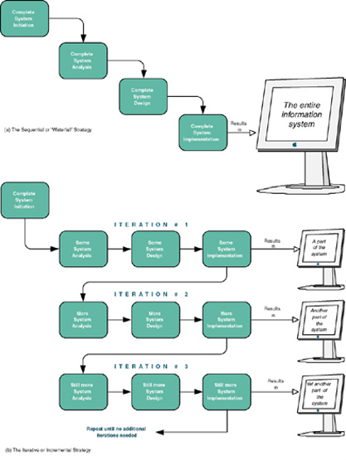
Sequential vs. Iterative

Slide 27
Commercial Application Package
Requires careful selection to fulfill needs
Usually costly to purchase and implement
Requires redesign of existing procedures
Some in-house development required to fulfill all business needs

Slide 28
Computer-Aided Software Engineering
CASE tools are software that automate the drawing and analysis of system models and provide for their translation into application software
use a Repository or Dictionary to contain models, descriptions & specifications
allow forward & reverse engineering

Slide 29
Commercial Application Package Implementation Strategy
Advantages
Disadvantages
Systems usually implemented more quickly
Avoids staffing required to develop in-house solutions
Generally less expensive
Vendor assumes responsibility for improvements and corrections
Many business functions more similar than dissimilar for all businesses in a given industry
Dependent on long-term viability of vendor
Rarely reflects ideal solution
Often resistance to changes business processes to adapt to software
Notes:
Conversion Notes
This slide is new to the seventh edition.

Slide 30
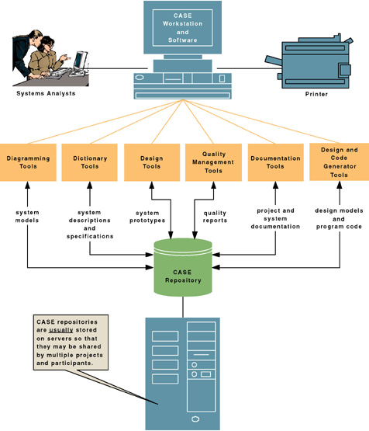
The CASE Environment

Slide 31
Application Development Environments
ADE are integrated software development tools that provide all the facilities necessary to develop new application software with maximum speed and quality
make prototyping and RAD programming possible

Slide 32
Process & Project
Management Software
Process Management
  an automated tool that helps document and manage a methodology, its deliverables, and quality management standards (CS10000)
Project Management
  an automated tool to estimate, assign, schedule, monitor, and control activities and resources of a project (MS Project)

